Slide 1

US USED CARS DATASET
Name:
Hieu hua
Vuong phat
Husan IFTAKHAR

Slide 2

Introduction:
Business Objectives: Optimize pricing strategies, understand vehicle demand, enhance customer decision-making, and improve inventory management.
Initial Analysis Goals: Identify pricing factors, predict time on market, and analysis
Success Metrics: RMSE, MAE, R-squared for models.
Technologies: Python (Pandas, NumPy, Scikit-Learn), SQL, Matplotlib, Seaborn.

Slide 3
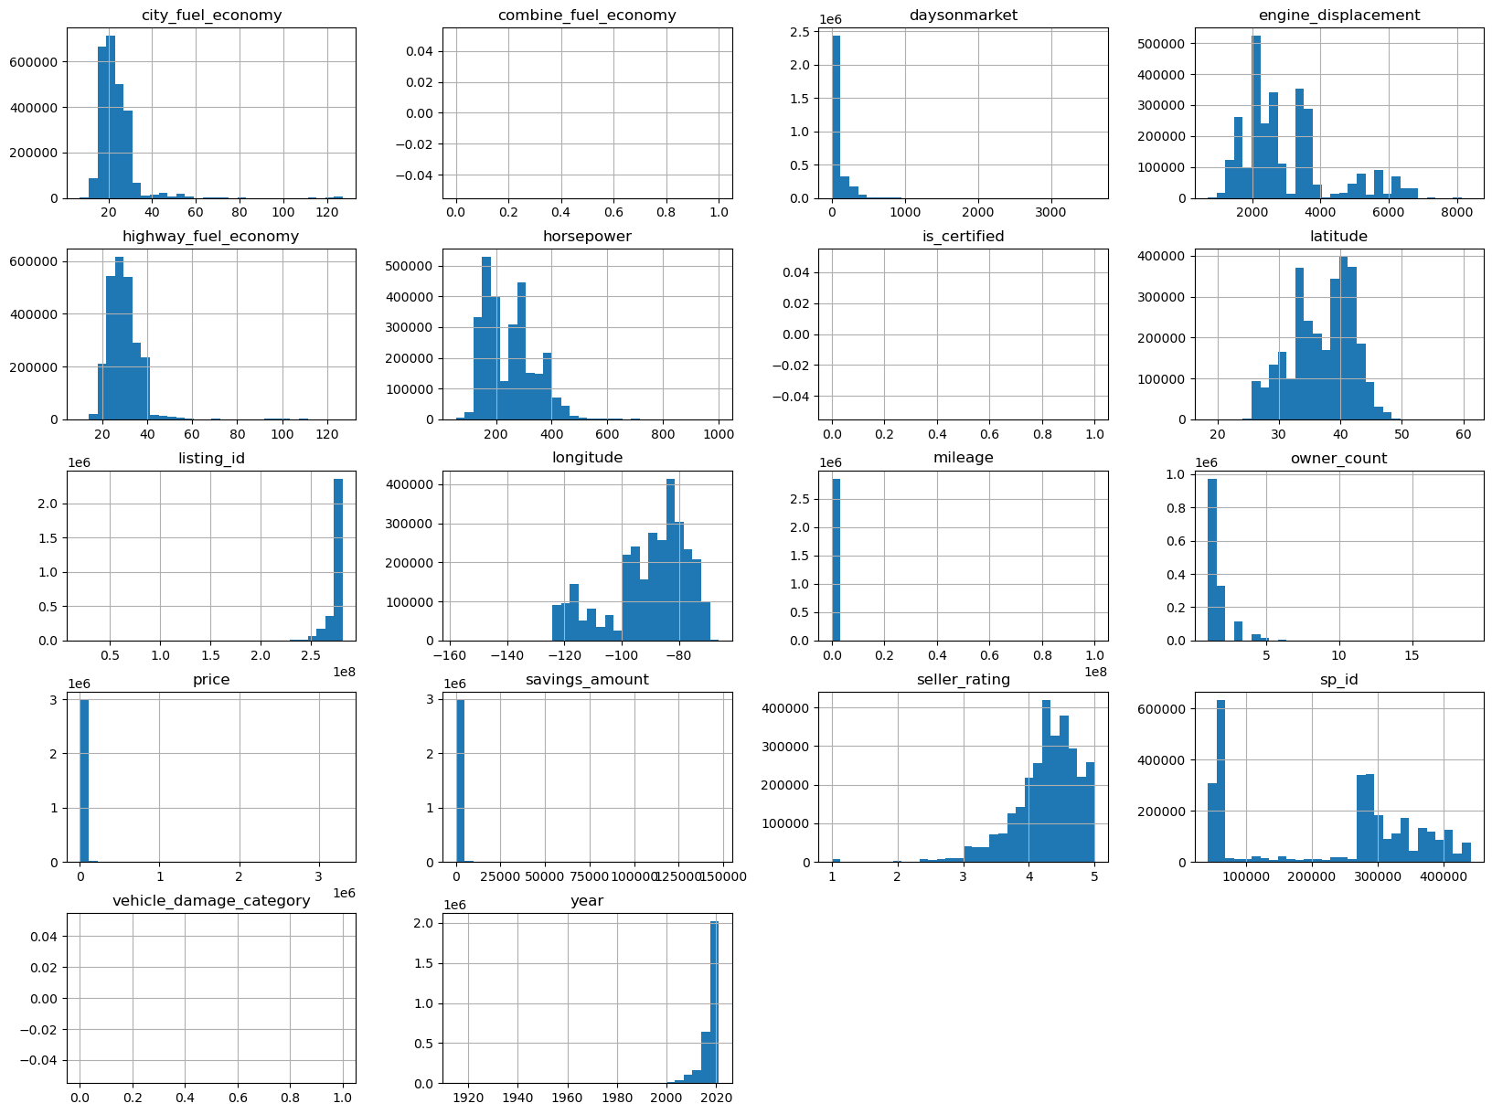
Phase 2

Slide 4
Phase 3
The average listing duration is 75 days
The average speed is 243 horsepower
The average vehicle is 5 seats
Most of vehicles being sold are relatively new, with an average mileage of 20,835 miles.
The average price of a vehicle is $29933.37
The average savings is $554.62.
……….

Slide 5
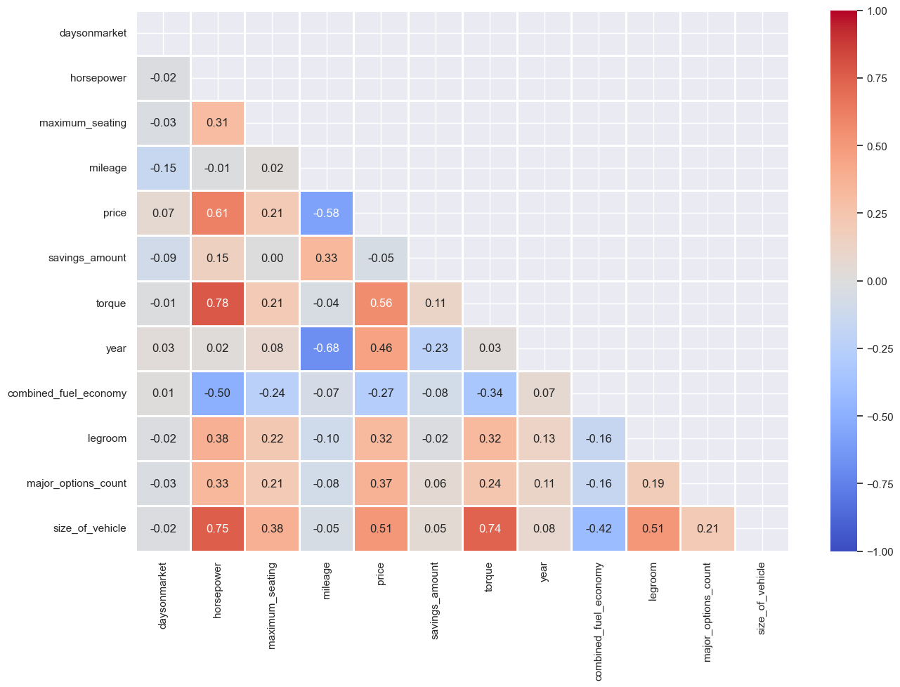

Slide 6
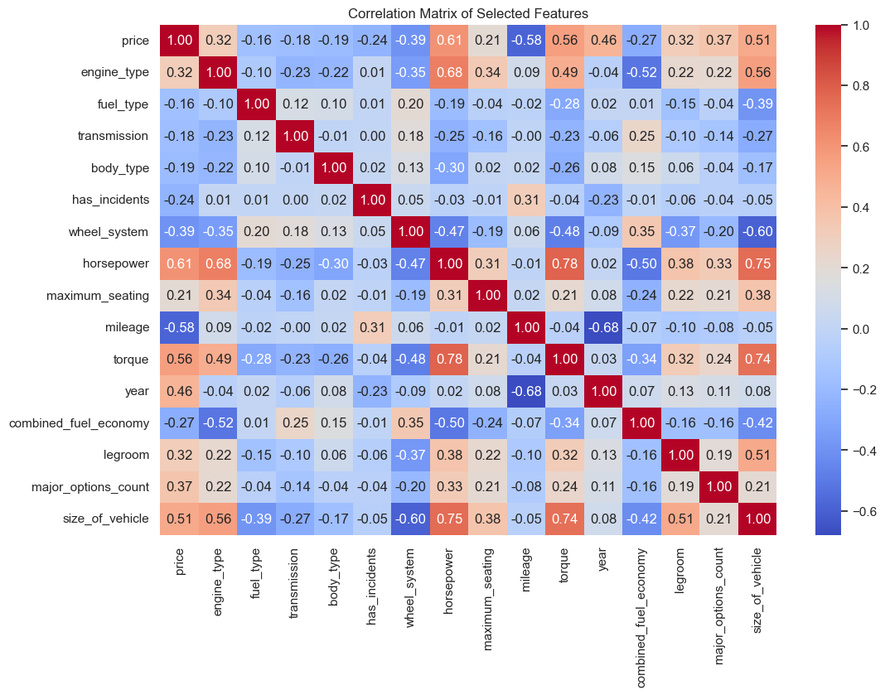

Slide 7
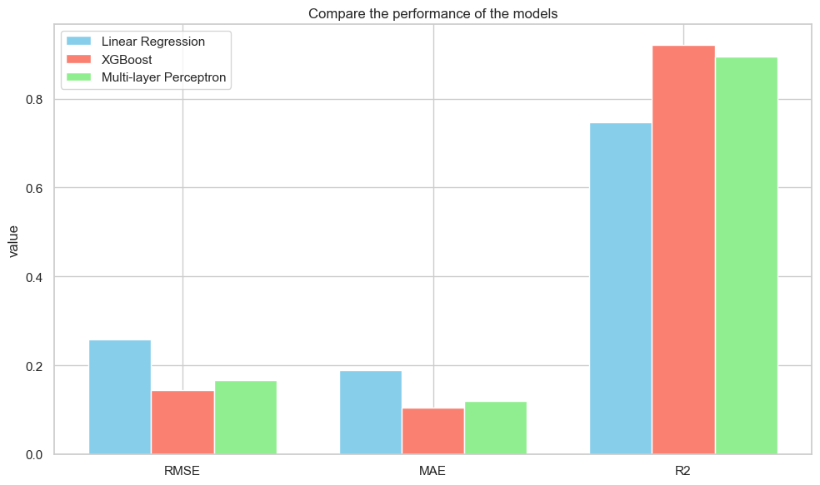
Phase 4 & 5 : Modeling & Evaluation

Slide 8





Phase 6 Overview: Deployment and Features
FastAPI backend serves HTTP endpoints
React UI communicates with FastAPI
Current capabilities:
Predict car prices
Add new data rows
Retrain models
Docker-based deployment with one command docker compose up –d
Logs can be seen using docker logs command
This Photo by Unknown Author is licensed under CC BY

Slide 9
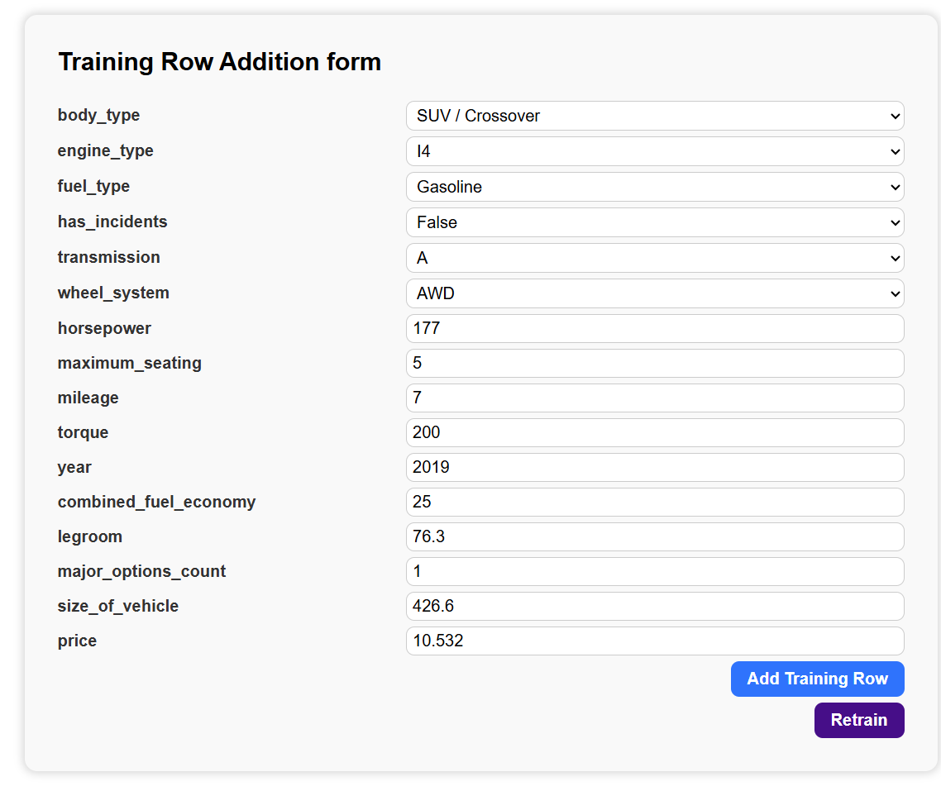
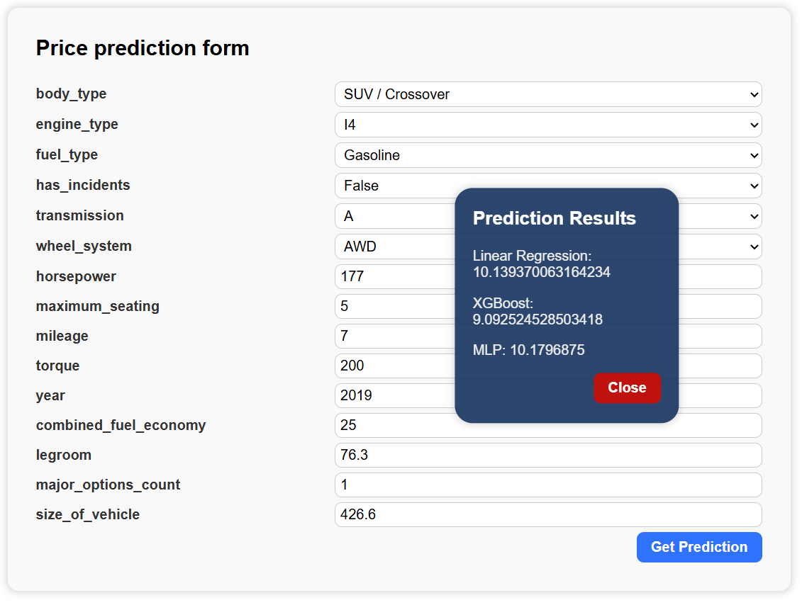
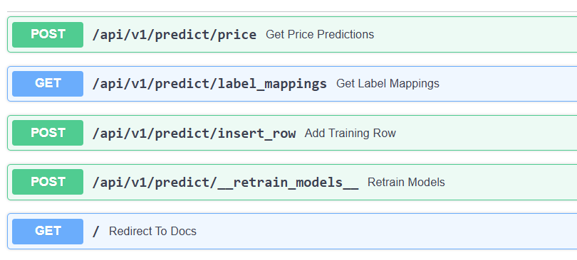
Add data and retrain
Get predictions

Slide 10
Future plans
Deployment plans
Linux machine on cloud with docker
Google Cloud IDX
Making UI look good
Testing
Monitoring
Data backup
Adding more recommendation models for other useful columns like days_on_market
Manually verifying the newly trained model’s accuracy

